Slide 1
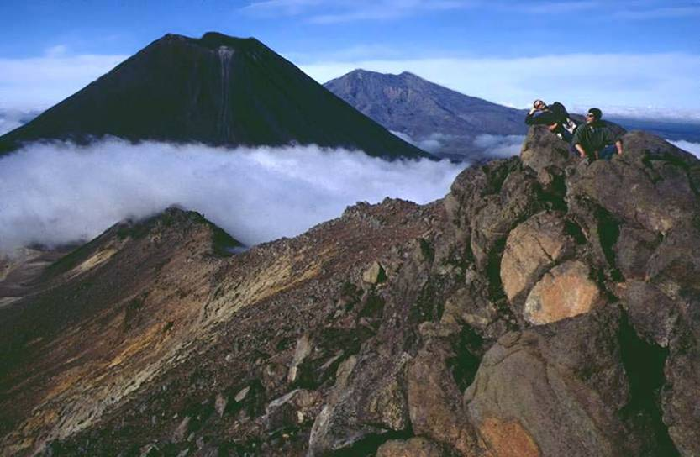
Tongariro National Park
Aim: To examine and explain weather variations horizontally and vertically in TNP

Slide 2
What could affect climate?
How would climate vary along the Tama Lakes Walk, in Whakapapa and in Turangi township?

Slide 3
Altitude
Altitude is height above sea level = vertical variation
Temperatures decrease by 4 degree celsius for every 1000 metres increase in altitude. Mountainous areas are therefore cooler.
Altitude affects the temperature of the air because air pressure gets lower as the altitude increases. The higher the pressure of any gas -- like our air, for example -- the warmer it becomes. When you relieve that pressure, the gas cools
How does the altitude change along the Tama Lakes Walk?
What altitude is Whakapapa and Turangi?

Slide 5
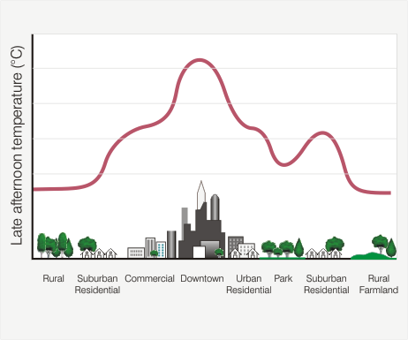
Microclimate
Is a local zone where climate can differ from the surrounding area
Things that can influence this include:
Soil colour – darker soils absorb radiant energy more than lighter soils
Moisture in soil – wet soils are normally dark but water takes energy to warm up = a moist soil warms more slowly than a dry soil

Slide 6
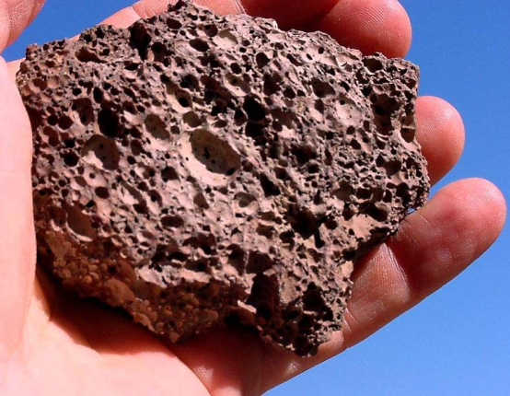
Rock type
Surfaces have different reflection rates for heat
Red Crater was formed about 3000 years ago and lies within a scoria cone which rests on top of the older Tongariro lava flows. The red colouring is due to the presence of oxidized iron in the rock.
How do you think this could affect temperature readings?

Slide 7
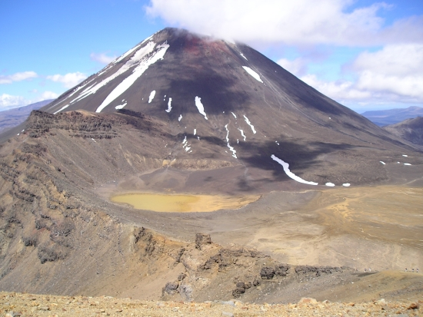
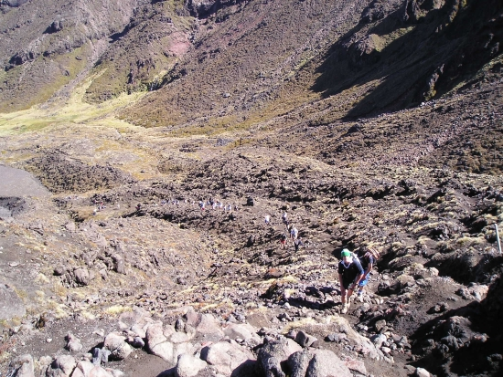
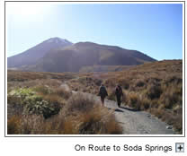
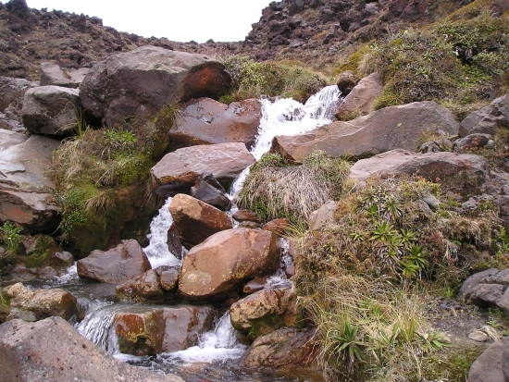

Slide 8
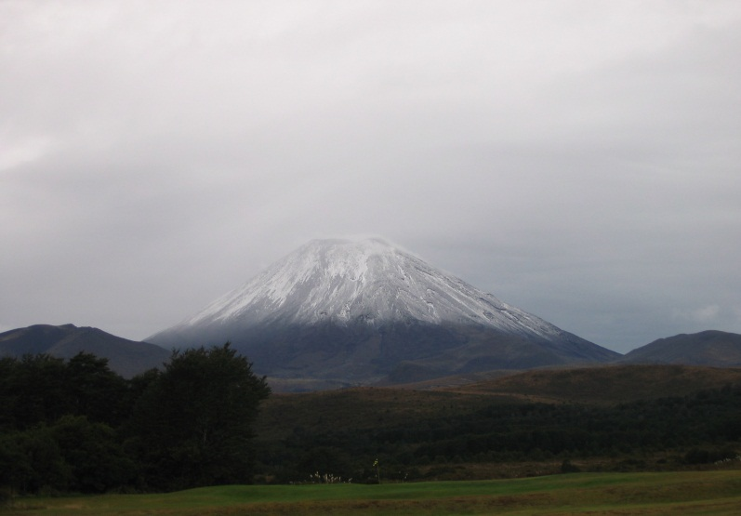
Snow cover
During winter conditions when snow and ice cover the track
Do you think we would expect to see snow on the Tongariro crossing. Why/why not?

Slide 9
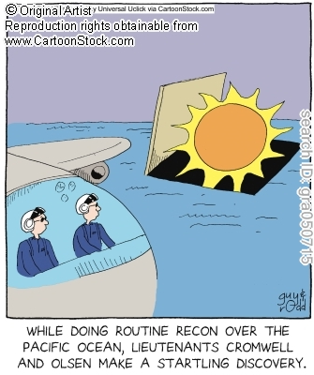
Sun angle
In New Zealand the sun rises in the East and sets in the West. Maximum temperatures are usually recorded when the sun is overhead at midday.
What data would you record with your temperature readings?
How will you measure
temperature to keep
measurements consistent?
How does this method differ
from the method the Met
service uses to show temperatures
e.g. on TV?

Slide 10
Wind
Closer to the ground wind speed decreases because of frictional drag on the surface.
How would you measure wind speed and direction?
Do you think wind speed will affect temperature?
Would wind speed be different in Whakapapa and Turangi?
What could cause differences?

Slide 11
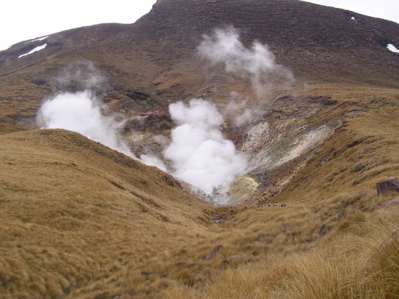
Heat under ground
The TNP is a volcanic area.
Do you think this could affect the soil temperature?

Slide 12
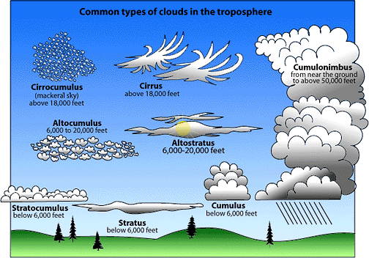
Observation of cloud type and % of sky covered

Slide 13
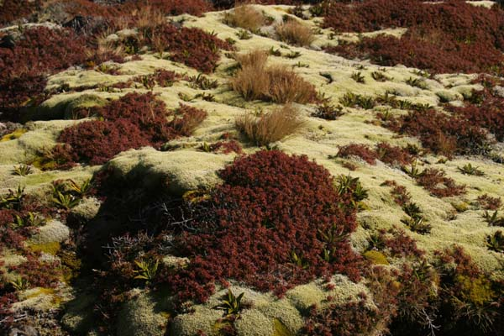
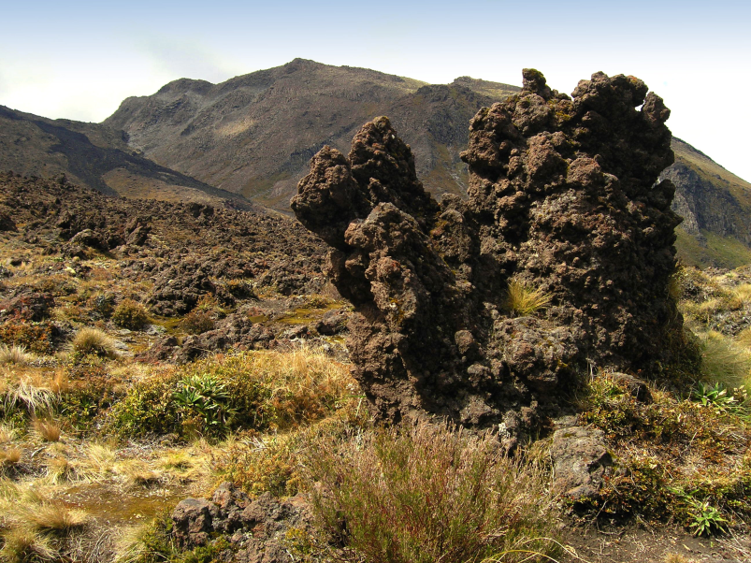
Vegetation
What pattern of vegetation would you expect to see on the crossing?
How could vegetation affect your measurements?

Slide 14
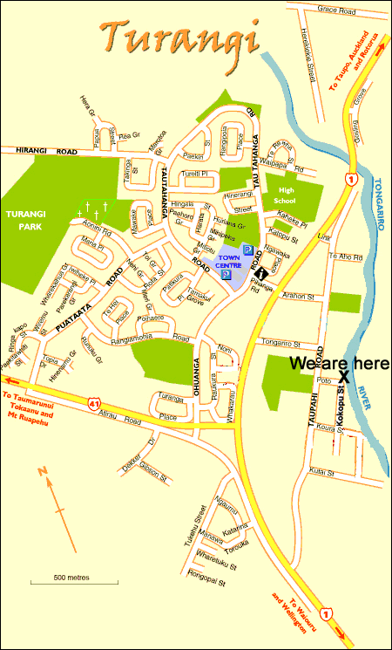

Turangi
At the 2001 Census of Population and Dwellings
Numbers of people counted
 | Turangi | New Zealand
Males | 1,677 | 1,823,007
Females | 1,764 | 1,914,273
Total | 3,441 | 3,737,277
From this information:
What conclusions can you make about Turangi?
What types of surfaces would you expect here?
How could these surfaces affect your measurements?
What would you measure here and why?
Where would you measure this information?

Slide 15
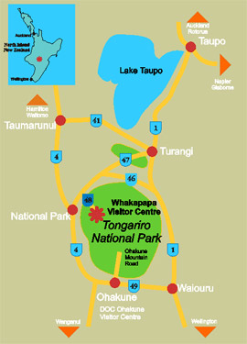
Whakapapa
The Whakapapa Visitor Centre is situated at the main gateway to Tongariro National Park.
What types of surfaces can you see at the visitors centre?
What surrounds the visitors centre?
Are they reflective or do they absorb energy?
How could these surfaces affect your measurements?
What measurements would you take here?
Where would you take the measurements and why?

Slide 16
Waihohonu Traverse
This walk takes about 7 hours, 1.5 hours to the Waihohonu Hut and 5 .5 hours to Whakapapa.
This walk includes the Taranaki Falls, Tama Lakes, Waihohonu Historic Hut and Ohinepango Springs

Slide 17
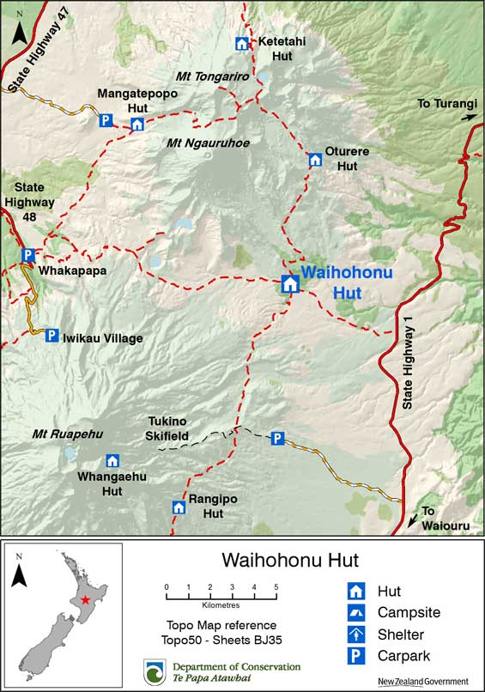

Slide 18
From the Hut the track follow the Waihohonu stream gradually climbing to the Tama saddle. The Tama Saddle is exposed and can be windy in bad weather on reaching the saddle a track branches right to Tama Lakes, two partially in filled explosion craters.

Slide 19
Whakapapa Village to Waihohonu Hut
Time: 5 hr 30 min Distance: 14.3 km
The track begins along Ngauruhoe Place, 100 metres below Whakapapa Visitor Centre. There are two options. The Lower Taranaki Falls Track crosses tussock and shrubland before following the Wairere Stream through mountain beech forest to the base of Taranaki Falls. On leaving the falls, the track climbs a set of steps and brings you to the junction with the Upper Taranaki Falls Track (1.25 hours to this point). Alternatively, the Upper Taranaki Falls track takes you over tussock and shrubland to the same point in 1 hour.
After leaving the Taranaki Falls Track, it is a further 2 hours to Tama Saddle and Tama Lakes junction. From here a side trip can be made to the Tama Lakes. Tama Saddle is exposed and conditions can be windy in bad weather.
From Tama Saddle the track gradually descends for 2.5 hours down the Waihohonu Stream to Waihohonu Hut. A side trip can be made from the Round the Mountain track to the historic Waihohonu Hut, about 10 minutes before you reach the new Waihohonu Hut.

Slide 20
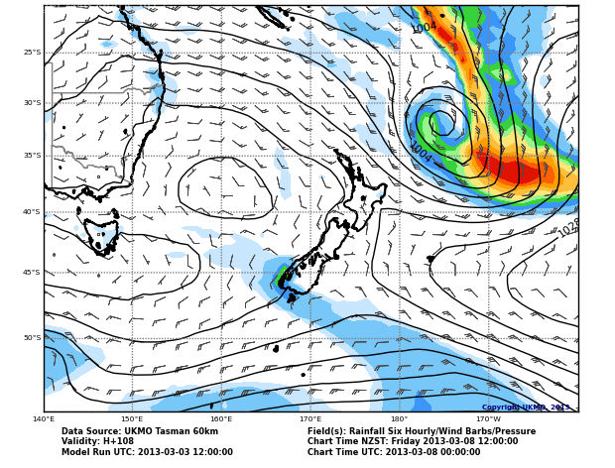
Weather forecast for Friday 9 March Tongariro
Friday - 8 March
Fine with light
winds.
Freezing Level:
Above 3000 mtres.

Slide 21
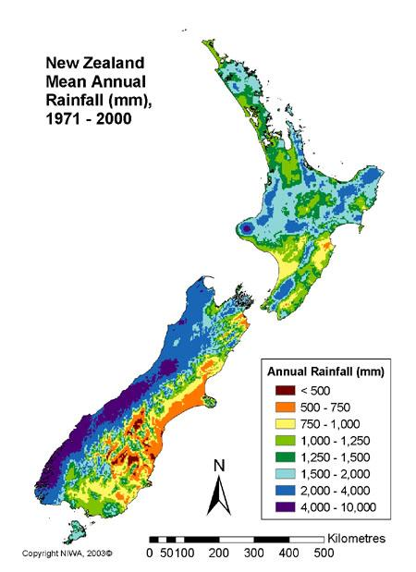
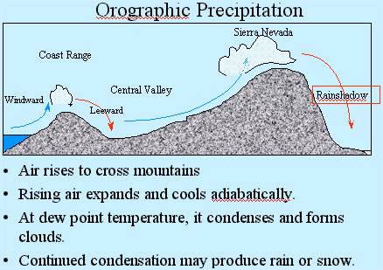
Orographic Rainfall in the TVC

Slide 22
Climate data for Chateau Tongariro 2010m above sea-level
Draw a climate graph to show mean rainfall and temperature:
Month | Jan | Feb | Mar | Apr | May | Jun | Jul | Aug | Sep | Oct | Nov | Dec
mean rainfall (mm) | 200 | 194 | 171 | 219 | 266 | 271 | 265 | 248 | 243 | 260 | 250 | 251
mean temp (°C) | 11.8 | 12.3 | 10.8 | 8.1 | 5.4 | 3.1 | 2.4 | 3.1 | 4.5 | 6.4 | 8.1 | 10.2
No. of days with snow | 0.1 | 0.1 | 0.2 | 0.6 | 1.8 | 2.7 | 3.1 | 3.4 | 2.0 | 1.1 | 0.7 | 0.4

