Slide 1
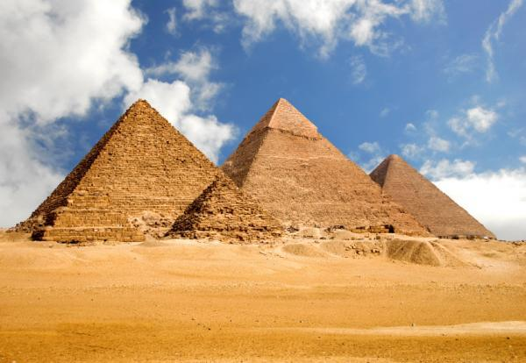
Population Pyramids quiz

Slide 2
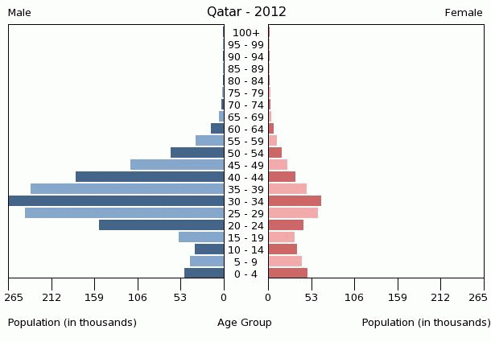
DESCRIBE THE NAME OF THE PROCESS THAT COULD EXPLAIN THIS POPULATION pYRAMID.(HINT REMEMBER THE POPULATION CHANGE EQUATION)

Slide 3
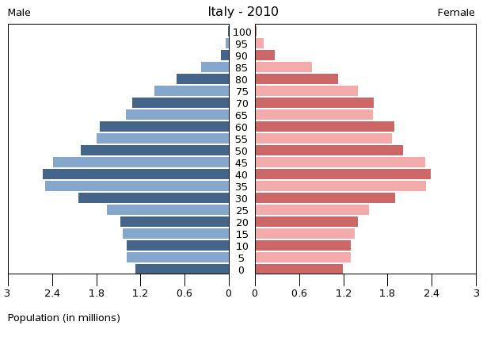
This would be called an ________? Population

Slide 4
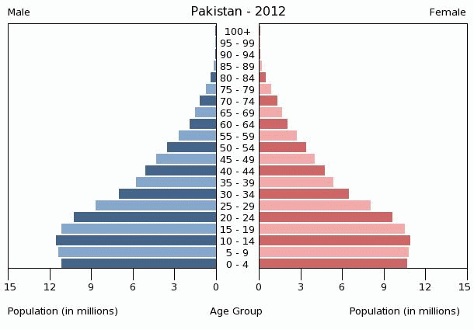
THIS WOULD BE CALLED A _______ ? pOPULATION

Slide 5
What is your understanding of the burden of dependency

Slide 6
Burden of DEPENDENCY
People who are younger than 15 years or older than 64 years have to be supported by working-age people. This is called the burden of dependency.

Slide 7
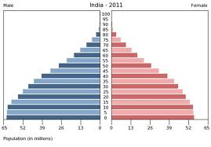
INDIA POPULATION PYRAMID

Slide 8
India
What kind of population is it?
What burden of dependency of issues may india have?

Slide 9
History lesson
India 1800s to early 1900s
Describe India Population in the 1800s to early 1900s.
Where would India have been in the demographic transition model. Give reasons for this?
Population Boom
When did India population start to accelerate?. What factors led to this population boom?

Slide 10
Youthful population
Make a creative diagram with the factors with arrows contributing to A India Youthful Population.
Coming out from this have arrows coming out of Youthful population that talks about the positive and negative consequences for India.

Slide 11
The girl boy imbalance.
According to the clip what contributes to the high abortion rate?
What is the government doing to address this problem?
https://www.youtube.com/watch?v=sZ7tZL547nU

Slide 12
See the difference

Slide 13
Make two categorieS
Girls: At least 6 bullet points with reasons that contribute to parents not wanting to have girls in the country
Boys: At least 6 bullet points why boys are highly favoured by Indian Parents.

Slide 14
Governments response vrs Continuing issues
Describe the different responses the Government has carried out to address the girl problem. Explain why issues still persist.

