Slide 1
INDIAS Youthful POPULATION/ The gender issue

Slide 2
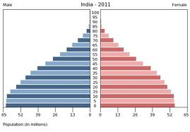
Describe the difference between the genders on this population pyramid

Slide 3
The girl boy imbalance.
1) According to the clip what contributes to the high abortion rate?
2) What is being done to address the problem?
3) Why do issues persist?
https://www.youtube.com/watch?v=sZ7tZL547nU

Slide 4
ANSWERS
1)According to the clip what contributes to the high abortion rate? Page 99 Population Concepts Values
Science Technology with ultra sounds. Dowry system to expensive for poor families
2)What is being done to address this problem?
Made dowry system illegal .Doctors are not allowed to reveal gender to parents. Education, and awareness
3)Why do issues persist?
Doctors succumb to parents pressure and reveal gender. People holding onto old values. Dowry system still persists despite being made illegal.

Slide 5
Make two categories
Girls: At least 4 bullet points with reasons that contribute to parents not wanting to have girls in the country
Boys: At least 4 bullet points why boys are highly favoured by Indian Parents.

Slide 6
INDIAS youthful population A good or bad SITUATION?

Slide 7
Evaluate positive and negatives consequences of Youthful population
Evaluate the positives and negative consequences of India's’ youthful population. Then justify your opinion whether you think India's population situation is overall negative or positive.
Use Page 98 Population Concepts, and any other relevant details to support your answer.

