Slide 1
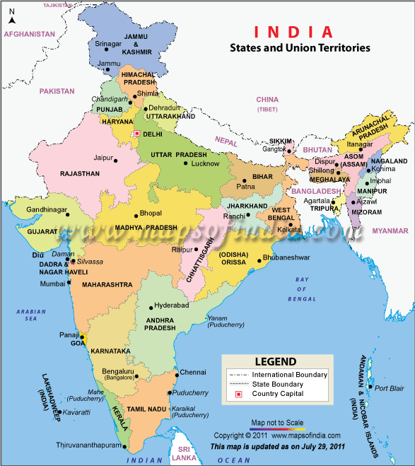
India – Population Issues

Slide 2
Fact Box
71% of people have no sanitation facilities
57% have no access to safe water
57 million children under 5 are malnourished
1.2 million ‘under 5’s’ die each year
350 million people live on less than $US1 a day
30% of men and 52% of women are illiterate
Infant and maternal mortality rates are high
75 – 80% of rural people live in poverty
Over 60% of urban dwellers live in slums

Slide 3
Population Growth
Year | Population (1000’s)
1950 | 369 880
1960 | 445 857
1970 | 555 043
1980 | 687 029
1990 | 841 655
2000 | 1 002 708
2010 | 1 184 091
2020 | 1 362 053
2030 | 1 532 646
2040 | 1 684 312
2050 | 1 807 879

Slide 4
Reasons for high birth rate
High birth rates and improving life expectancy
Falling death rates
Children provide families with labour and wages
Rural child-rearing costs are low
Children are a family’s insurance against future problems
Religious beliefs place high value on children
Consequences
Rapid future population growth
Rural Over- population
High burden of youth dependency
High costs of education and child care
An assured labour force for the future
Low costs of providing for the elderly
Y
O
U
T
H
F
U
L
P
O
P
U
L
A
T
I
O
N

Slide 5
When India began to modernise during the 20th century:
Safe water, food and medicine supplies improved and death rates fell
Birth rates remained high because poor rural families need children, and Hindu and Muslim teachings encourage large families

Slide 6
The government cannot force people to do what it wants.
Government advice is often ignored.
Islam forbids the use of contraceptives – hence Muslim families are large.
Muslim men are in control – if they want more children they get them.
Hinduism provides greater choice.

Slide 7
Putting on the brakes
India’s government has promoted family planning programmes since the 1970’s:
Families are urged to have fewer children
Contraceptives and sterilisations are readily available (sometimes with cash rewards)
Child marriages have been banned and the legal marriage age raised to 18

Slide 8
However, in the early 21st century, some Hindu leaders noticed that the Hindu population was growing slower than the Muslim population, and so advocated a ban on birth control.
Family planning has been more successful in the cities.
List reasons…

Slide 9
Sons versus Daughters
Families want boys because:
Hindu and Muslim religions place a high value on sons
Sons grow up to be family breadwinners
Adult sons look after their ageing parents
Sons preserve the family line
Hindu sons light their fathers’ funeral pyres to send their soul to heaven
Sons give their mothers status and security in Indian families
Families do not want girls because:
Dowry and wedding expenses are a huge financial drain
Daughters leave their families when they marry
They are seen as a waste of family resources
Daughters do not bring status and security to their mothers

Slide 10
Modern technology allows parents to identify the sex of an unborn child.
In many cases, when female children are detected, foetuses are aborted (one advertising poster states “Spend 500 rupees now and save 50 000 rupees later.
The UN says that 2000 female foetuses are aborted every day in India.
This practice is illegal.

Slide 12
Population characteristics in Kerala and Uttar Pradesh
 | Kerala | Uttar Pradesh
Number of females per 100 males | 104 | 88
Infant mortality rate (per 1000) | 17 | 98
Female life expectancy (years) | 74 | 55
Male life expectancy (years) | 69 | 57
Female literacy rates (%) | 86 | 25
Male literacy rates (%) | 94 | 56
Total fertility rate (number of children per woman) | 1.8 | 5.1
Economic growth (%) | 0.3 | 2.2

Slide 13
Task – Use the table to answer these questions
1. Kerala and Uttar Pradesh are predominantly rural areas. Which is more prosperous?
2. What evidence is there that women are treated better in Kerala?
3. What happens to family size when women have more say?
4. Suggest reasons for the different male-female ratios and infant mortality rates between the two states.
5. In which state would you expect to find fewer social problems? Why?

