Slide 1
Geography Skills
Level two
2.4
Apply skills and ideas with guidance in a geography context

Slide 2
What is Geography?
Brain storm in pairs
What is Geography?
What do theses terms mean?
I.G.Is (Important Geographical Ideas). Name as many as you can
FQns
Setting
Skills

Slide 3
Geography
= Interaction between people and the environment
What is the purpose and nature of school Geography?
To develop an understanding of the interaction between people and the environment.
To develop your thinking and practical skills
To develop an awareness of others point of view and develop your own perspective.
Develop an appreciation towards your surrounding environment.

Slide 4
Key Terms
I.G.I’s = System, pattern, distance, culture, location, change, perception, interaction, process, accessibility, region.
FQns = Focusing Questions = Key questions which give the essences on what is going to be taught.
Setting = Sets the parameters of where the topic is set for example global or local.
Skills = Social, practical, valuing and thinking skills.

Slide 5
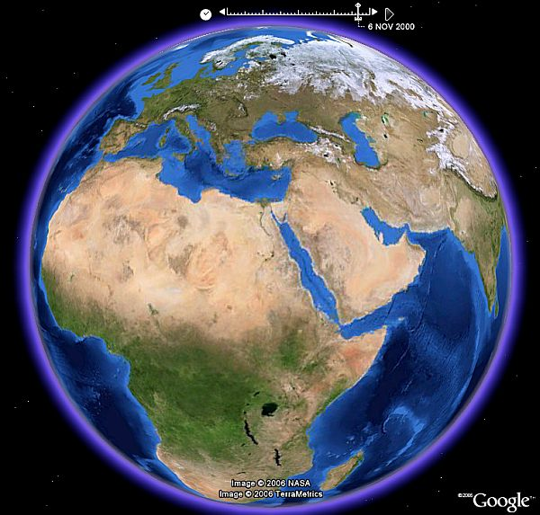
Scale
Global scale:
At a world scale, dividing the world into regions and geographers look for patterns.

Slide 6
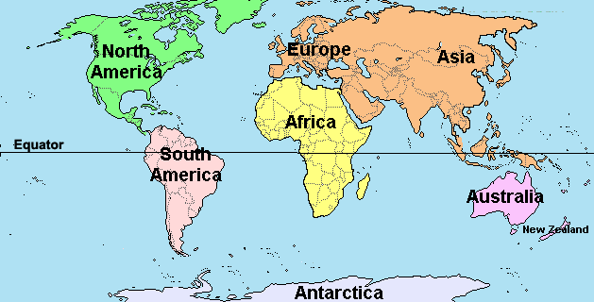
Scale
Continental scale
Looking at the main continents of the world e.g. Africa, Asia, America, Australia, Europe, etc.

Slide 7
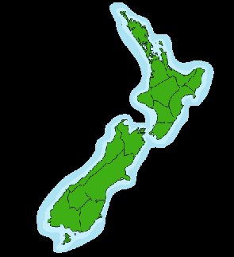
Scale
National Scale
Look at Individual countries
Identify patterns between countries
Eg New Zealand

Slide 8
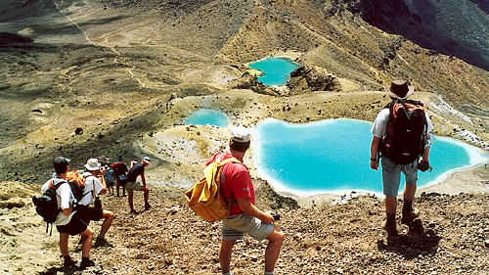
Scale
Local Scale
Look at factors that affect only a small part of the earths surface.
e.g. Tongariro volcanic centre

Slide 9
Ratio
Large Scale
1: 100 = 1cm = 1m
1: 1000 = 1cm = 10m
1: 10,000 = 1cm = 100m
1: 100,000 = 1cm = 1km
Write this in the front of your book
How many:
cm : m = 1: 100
m : Km = 1: 1000
mm : cm = 1: 10
cm : km = 1: 10, 000

Slide 10
Latitude
Watch latitude and longitude you tube clip
(simple version)
Watch latitude and longitude you tube clip
(in depth clip)
You are now to draw in book from memory:
North and south pole
The equator
Topic of Cancer
Topic of Capricorn
Arctic circle
Atlantic circle
Temperate zone
The Tropics
How many minutes in a degree?
How many seconds in a minute?
How many miles is the earth roughly?

Slide 11
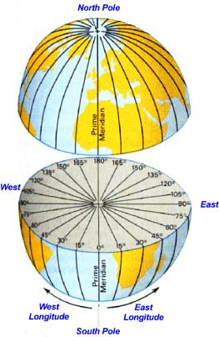
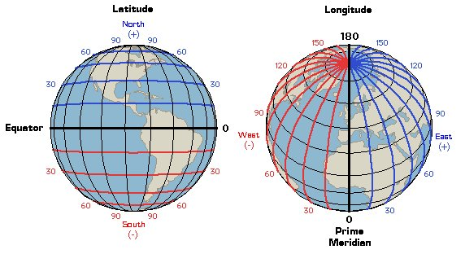
Latitude and longitude
1 Degree: 60 minute
1min: 60 seconds
The earths circumference = 25,000 miles
Write in the front of your work book

Slide 12
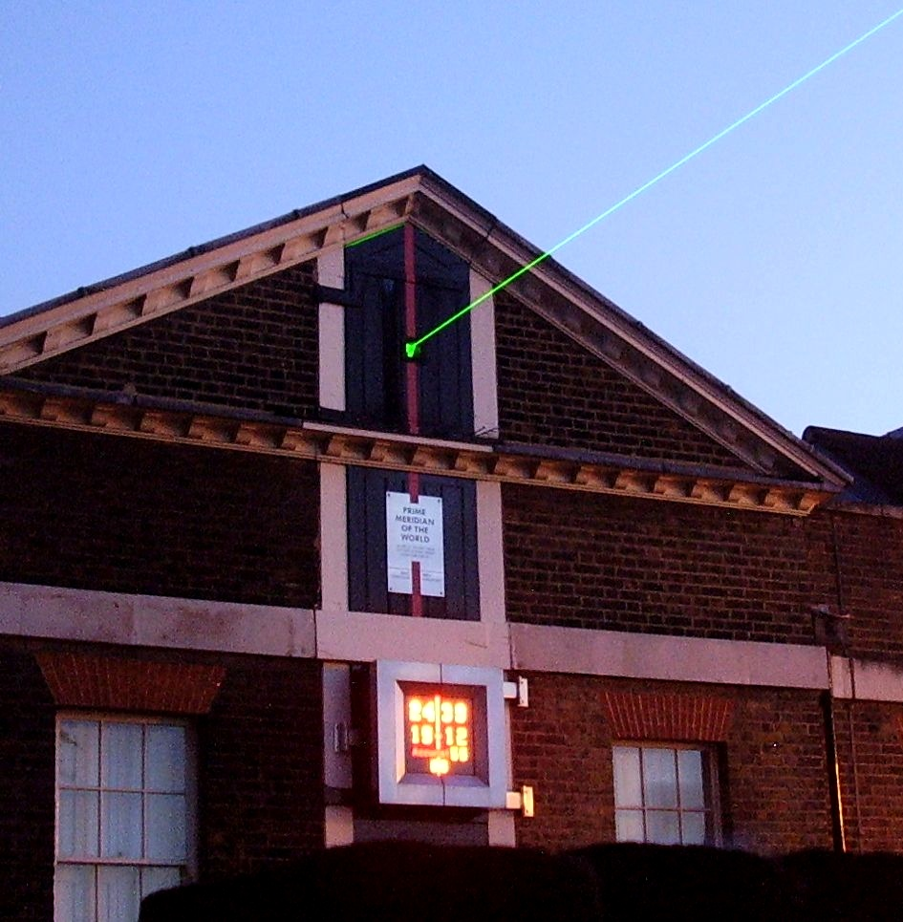
Why the Greenwich in the UK?
The modern Greenwich Meridian, based at the Royal Observatory, Greenwich, was established by Sir George Airy in 1851. By 1884, over two-thirds of all ships and tonnage used it as the reference meridian on their maps. In October of that year, at the behest of U.S. President Chester A. Arthur, 41 delegates from 25 nations met in Washington, D.C., USA, for the International Meridian Conference. This conference selected the Greenwich Meridian as the official Prime Meridian due to its popularity. However, France abstained from the vote and French maps continued to use the Paris Meridian for several decades.
The Greenwich Meridian is now marked at night by a laser beam emitted northwards from the observatory.

Slide 13
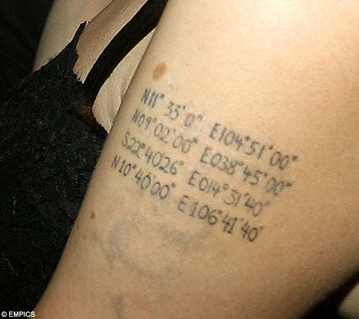
Locating a point on the earths surface
Give the longitude and latitude coordinates for:(Use an atlas to complete this exercise)
Moscow, Russia (to the closest degree)
Where did Angelina Jolie’s children’s children first entered her life using these geographical coordinates (longitudes and latitudes) to find their location of birth.
A) N11° 33' 00" E104° 51' 00“
B) N09° 02' 00" E038° 45' 00"

Slide 14
Answers
1. 57 degrees N and 38 degrees W
2 a) the place in Cambodia where Angelina Jolie's eldest son Maddox was born
2 b) the place in Ethiopia were her daughter Zahara was born.

Slide 15
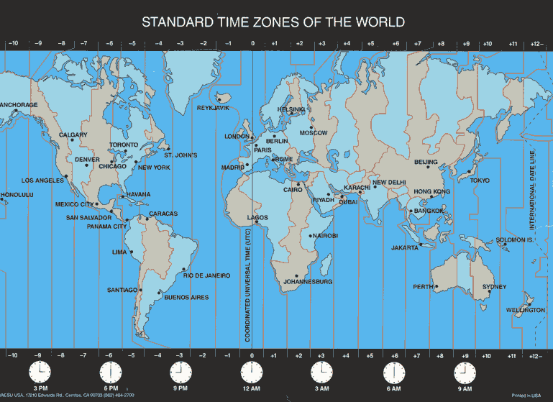
Time zones
Degrees are broken down into Minutes and seconds (The same as telling the ‘Time’).
‘Time’ calculates how long the it takes the Earth to spin around it axis.

Slide 16
Calculating Time Zones
A complete rotation of Earth = 24 hours
Earth spins through 360 degrees (because the earth is round).
The Earth spins 15 degrees latitude every hour
360° ÷ 24 = 15°
If a place is 15° away from you they are an hour ahead or behind.

Slide 17
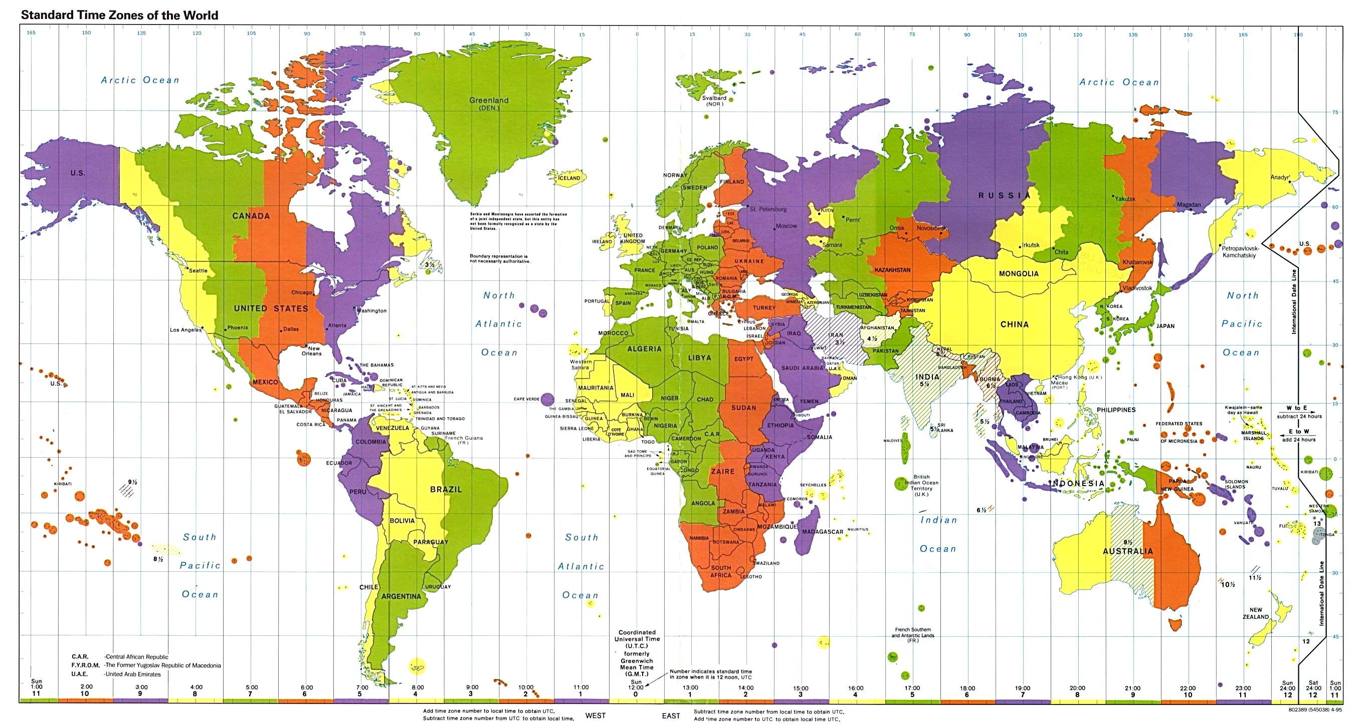
You tube clip: Time zone basics

Slide 18
Do Now
Complete page 13 ex 8 and 9 in your skills book

Slide 19
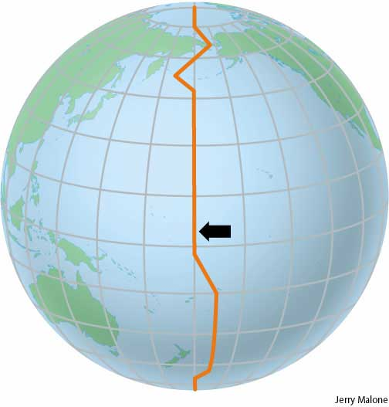

Slide 20
The International Date Line IDL
New Zealand is the first country to see a new day. No place is ahead of us at any time.
Places west of NZ or the IDL are hours behind us.
E.G. if it is 12noon in NZ then it will be 10am in Australia
Places east of NZ or the IDL are the day before (yesterday) but hours ahead of us.
E.G. if it is 12noon in NZ (Tuesday) then it will be 7pm in Chile but yesterday (Monday)
You tube clip: International Date Line
Wonky line

Slide 21
No Now
Complete pages 14 ex 9 and 10
Check your answers with Miss Dunham
Then complete page 15 ex 11 and 12

Slide 22
Topographical mapping Skills
Topography = shape of the land
Grid Referencing
Are made up of 6 figures.
3 figures relating to the Easting's or numbers along the bottom
3 figures relating to the Northing’s or numbers up the side.

Slide 23
Refresh - Location: Grids
Reading the map we can view it as a grid or a graph.
We usually start in the bottom left hand corner.
We always move from left to right and then from bottom to top. ie D2. Just remember, you must CRAWL before you CLIMB.
This can be vague because features can only be located somewhere inside a square
4
3
2
?
1
X
A
B
C
D
E
F

Slide 24
14 grid point reference
A 14 grid point reference is more compatible when using a GPS (Globe Positioning System)
Great for large regions and accuracy
7 figure easting and 7 figure northing

Slide 25
Determining direction
N
N
14
14
13
13
12
12
11
11
26
25
24
23
23
24
25
26
W
E
11
11
12
12
13
13
14
14
24
S
S
26
25
23
23
24
25
26
W
E

Slide 26
14 figure grid reference
Step one: first two digits = bottom left corner (relate to a 100km grid).
Step two: grid 3+4 normal grid reference, use the lines (relate to a 1km grid)
Step three: The fraction between the grid lines. (relate to the 100m grid)
Step four: Done by using a GPD (not a topographical map). (relate to the 1m grid)
Step five: Add direction e.g. N,S,E,W

Slide 27
Location: Grids
Numbers
The most important function of a map is to show us where we are. In order for us to do this we must use consistent conventions.
Most maps use a GRID to divide the map into areas.
On most Road maps one side is usually labelled with numbers down one axis and letters down the other.
Letters

Slide 28
Location: Grids
Reading the map we can view it as a grid or a graph.
We usually start in the bottom left hand corner.
We always move from left to right and then from bottom to top. ie D2. Just remember, you must CRAWL before you CLIMB.
This can be vague because features can only be located somewhere inside a square
4
3
2
?
1
X
A
B
C
D
E
F

Slide 29
Grid reference for x
95
x
94
93
5492000
2
28
29
30
3327000
Point x =
00
2
33
29
E
54
94

