Slide 1
Demographic Transition Model
https://www.youtube.com/watch?v=rWIc64W5wnM

Slide 2
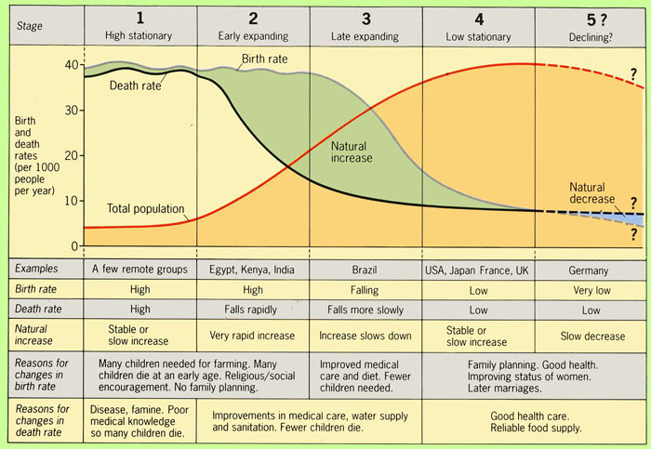

Slide 3
Page 92 Activities 1-4 Population Concepts

Slide 4
Monsoon Asian countries
Most Monsoon Asian countries were stage 1 in the 1950s
All have moved along the development path in varying degrees
Page 94 Activities 1-4, Population Concepts

Slide 5
Japan
https://www.youtube.com/watch?v=59tvl6mJGrQ
Where would have Japan been on the demographic model in 1950. 1973 and 2005
2 Activities 1a, b on page 95 Population Concepts

Slide 6
Page 97 Activities 1,2a,b,c, Population Concepts

