Slide 1
CHINA

Slide 2
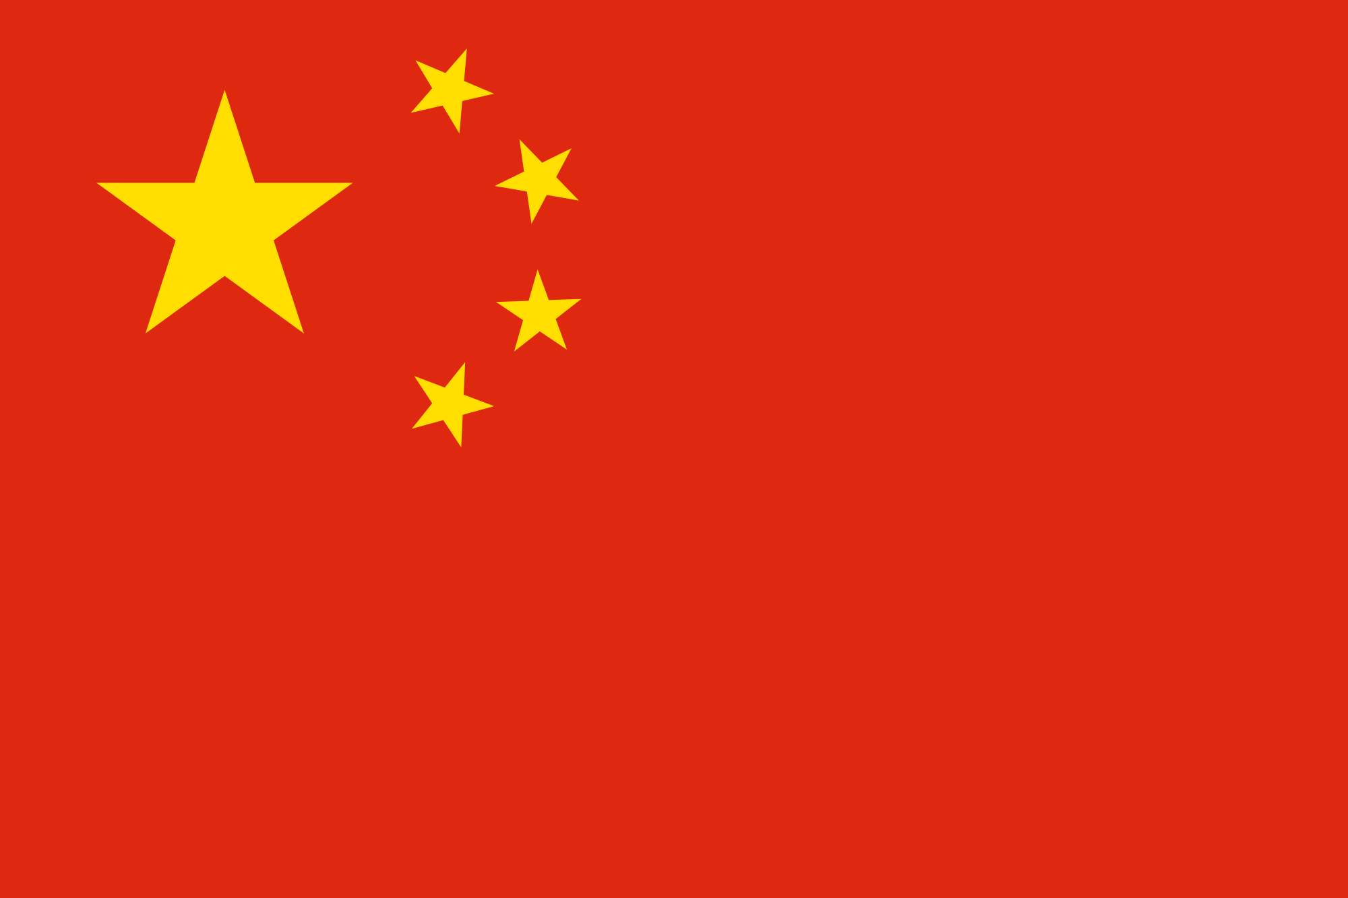

Slide 3
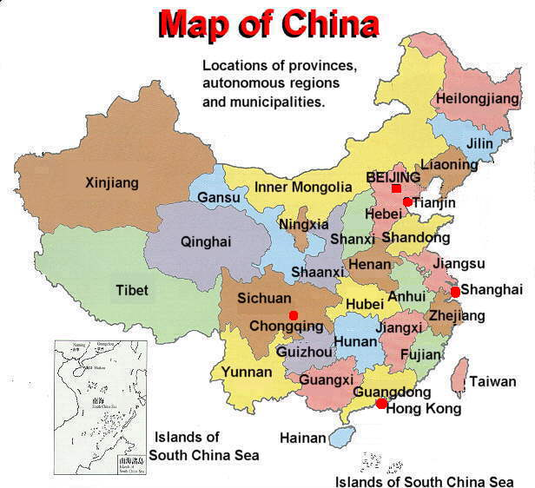

Slide 4
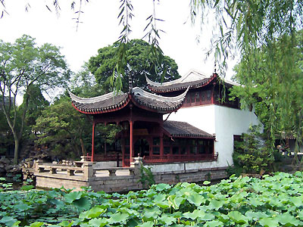
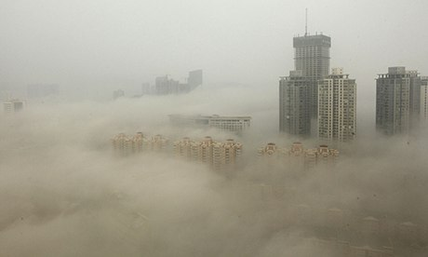
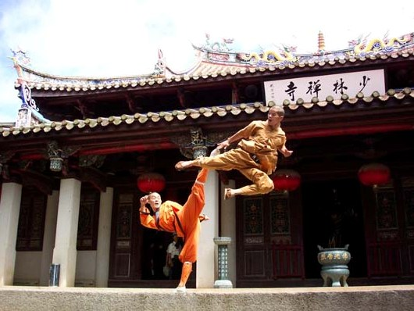
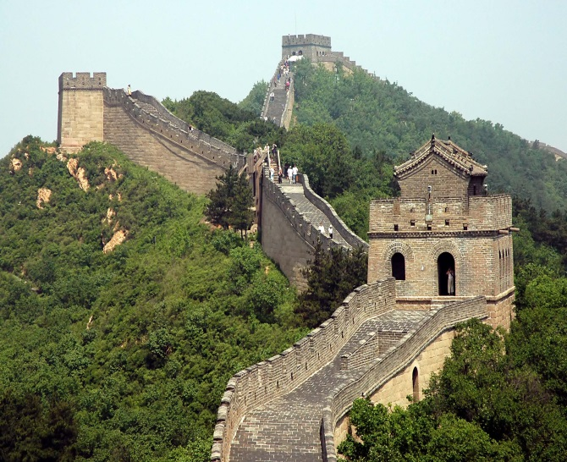
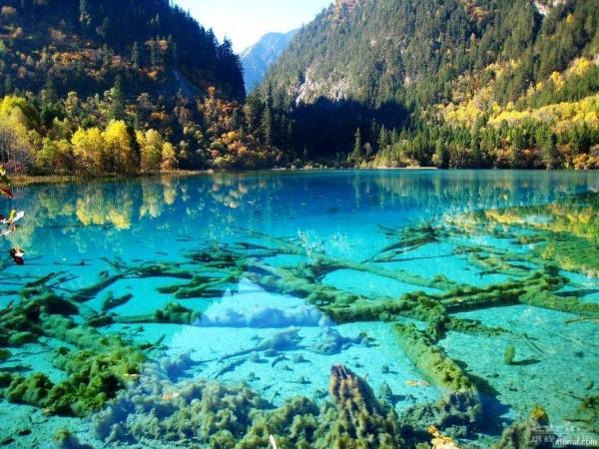

Slide 5
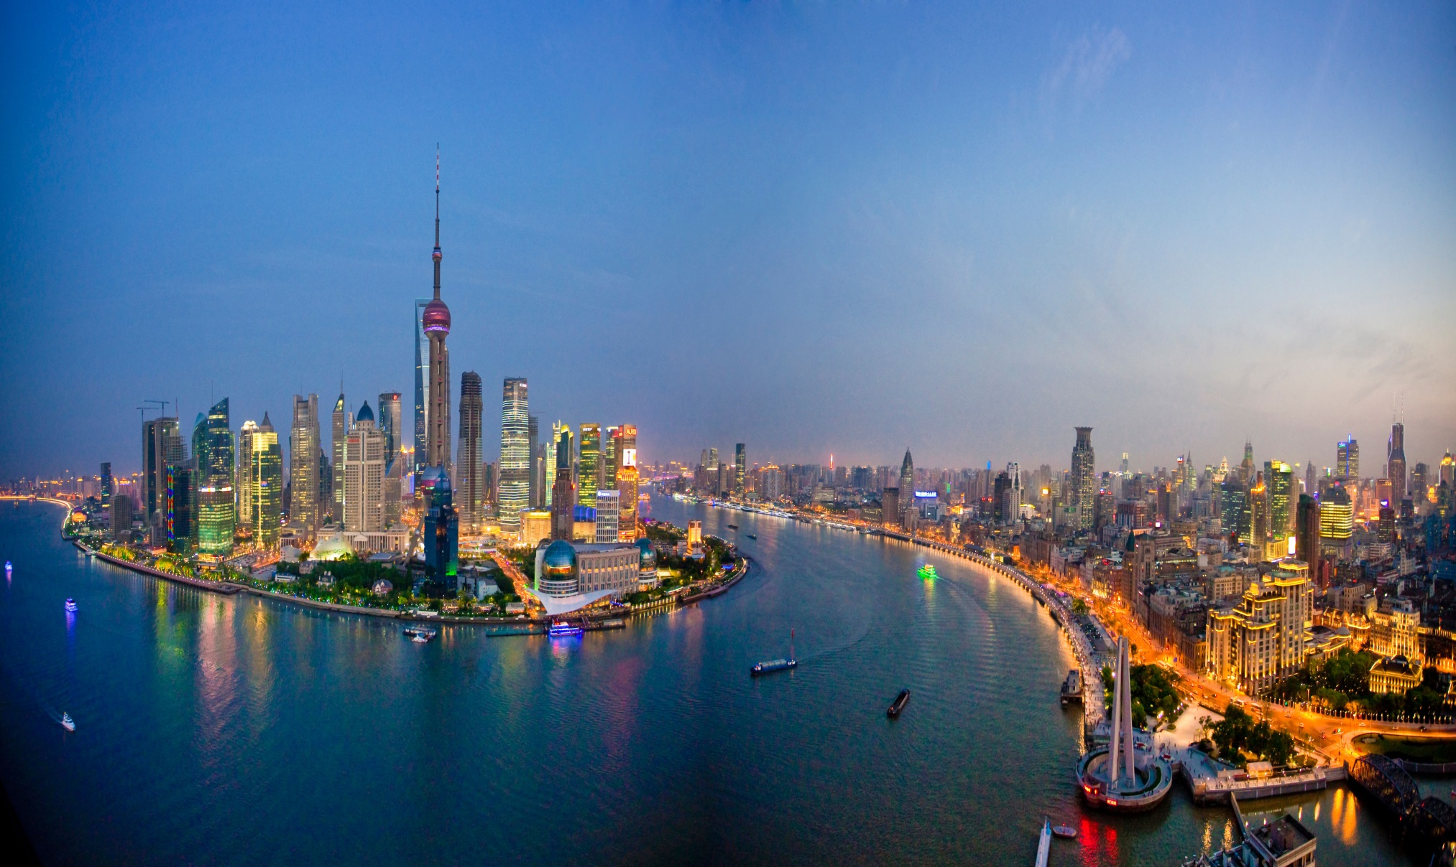
Shanghai City

Slide 6
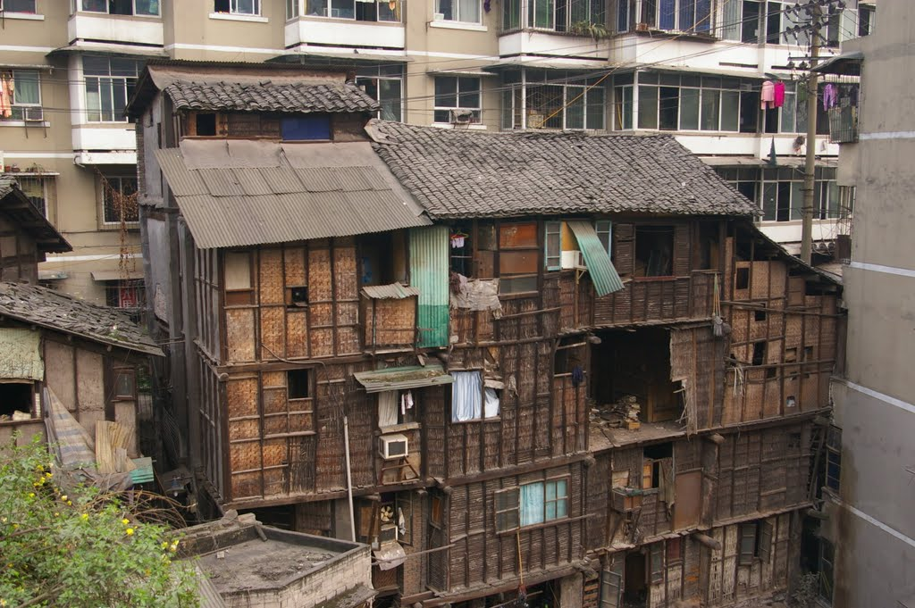
SLUMS

Slide 7
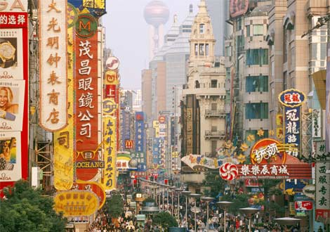
Beijing – Capital City

Slide 8
Interesting Facts
China has the largest population in the world, with over 1.3 billion people (1,343,239,923) as of July 2012.
47% of the population live in urban areas.
In 2003, China became the third country to successfully send a person to space.
The Great Wall of China is the largest man made structure in the world, stretching an incredible 8,850 kilometres (5,500 miles).
The famous Giant Panda is found near the Yangtze River in China.
China hosted the 2008 Summer Olympic Games in Beijing.
100 million people in China live on less than $1.00 per day
China uses 45 billion chopsticks every year
Facebook, Twitter and the New York Times have been blocked since 2009
China has the world’s biggest shopping mall but it’s 99% empty
Over 35 million people in China live in caves
Almost 1/3 of the air pollution in San Francisco gets blown across the Pacific Ocean from China
One in every 3 socks made in the world come from the district of Dating in Zhuji, China
Every year, about 5 million girl fetuses are aborted and tens of thousands of girl babies are abandoned in China because of the country's one-child policy.

Slide 9
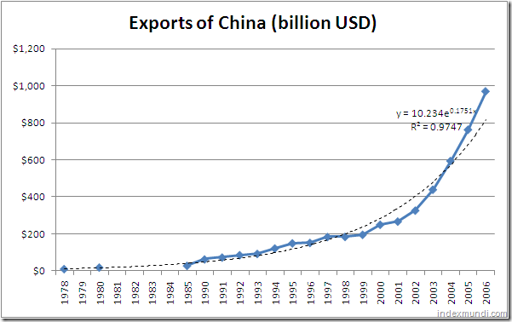

Slide 11
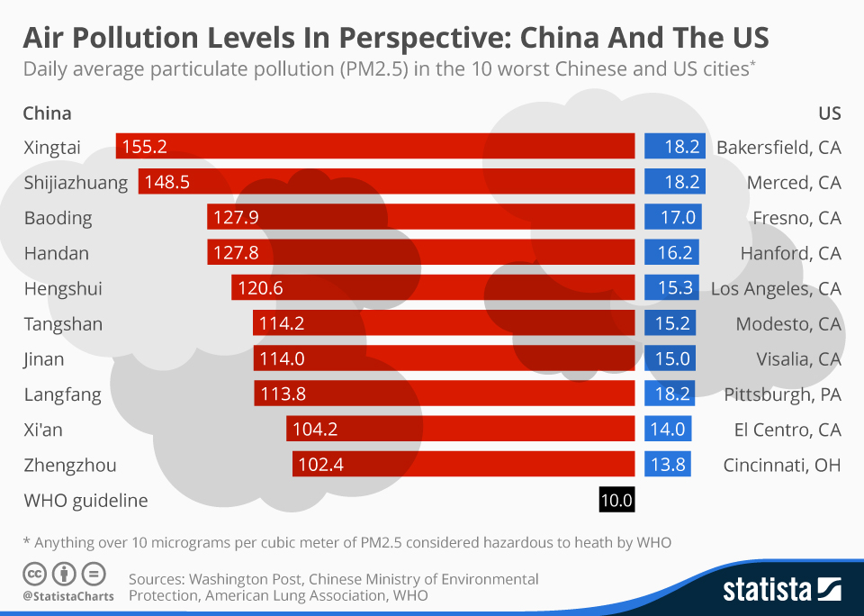

Slide 12
