Slide 1
Understanding 14 Figure Grid Referencing

Slide 2
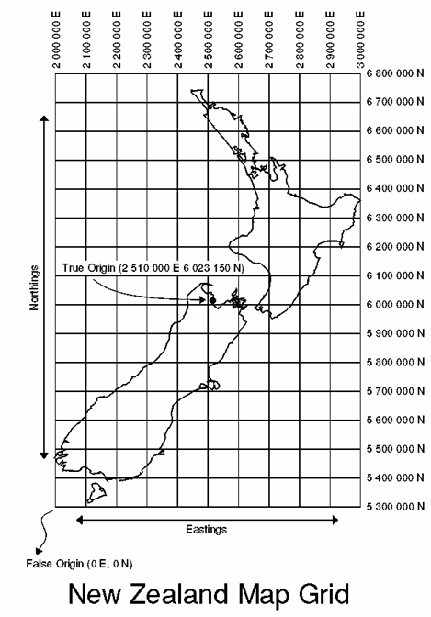
Background
Accurately locating places on a blank map outline is difficult
by putting a grid system over the top of the blank outline it is much easier to locate places accurately
Adding numbers to the grid allows us to create coordinates

Slide 3
We can use the coordinates to find specific locations - like playing Battleships
H4 G3 ..... Hit (in the square)
Except here we use 14 digits for pinpoint accuracy!!
X
2 700 000 E
6 400 000N

Slide 4
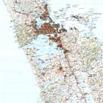
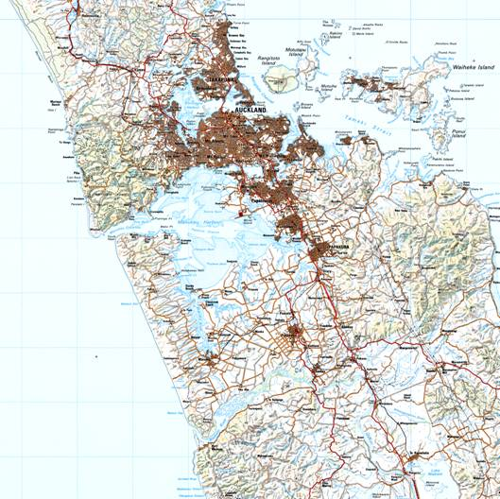
You can Zoom in from the NZ Grid to local areas

Slide 5
The Grid

Slide 6
With Numbers
First there is a Grid
6462000N
Numbers up the side are Northings
6461000N
Numbers across the bottom are Eastings
6460000N
2690000E
2691000E
2692000E

Slide 7
The Grid has graduations
6462000N
there are 1000 graduations between 61 and 62 too...
6461000N
There are 1000 graduations between line 90 and 91
6460000N
2690000E
2691000E
2692000E

Slide 8
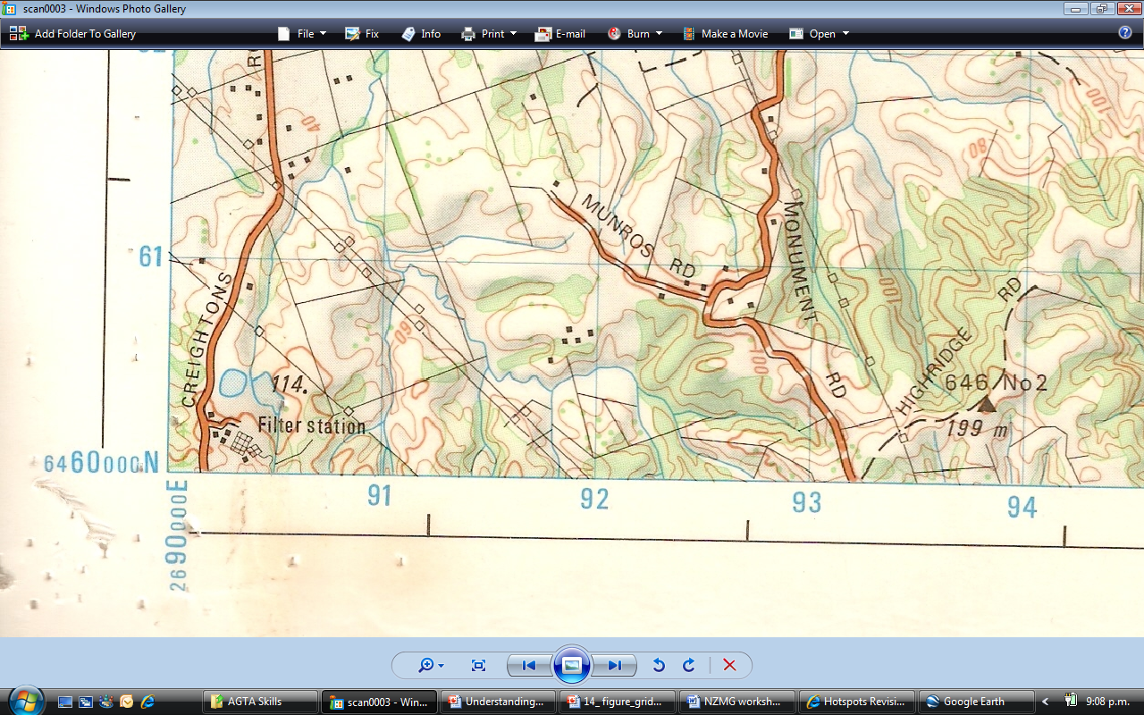
The Numbers let you locate points on the map
The first two digits 2690000E 6460000N are for the location in NZ –don’t worry too much about these two numbers
The next two digits 2690000E 6460000N are ones you see on the map grid as 90, 91, 92E... 60, 61,62N...these are your starting point

Slide 9
The Numbers let you locate points on the map
The final three digits 2692000E 6461000N indicate how far to go between each gridline
000 is smack on the gridline
.... 250 will be ¼ way across
500 will be ½ way across
750 will be ¾ of the way across......

Slide 10
Putting it together....
E.g. To find out what is at grid reference number 2693803E 6460425N.....
Go along the bottom to 26 93 803E and mark the point
Next go up the side to 64 60 425N
Then simply identify the feature where the two intersect
x

Slide 11
Acknowledgements
Peter Arthur – Howick College
Charlotte Gipps – Epsom Girls’ Grammar
http://www.nzgs.co.nz/ accessed 10/6/08
H McMillan – Saint Kentigern College
Martin Newton

