Slide 1
Natural Features of the TVC
Ruapehu

Slide 2
Climate and vegetations Zones on Ruapehus Southern slopes
Height (m)
Copy this diagram into your book – use page 59 of you can’t see this from where you are sitting ☺
Mt Ruaphu
2800
Temp drops 4 degrees per 1000m
2600
Wind and rainfall increases
2400
Snow/ice
2200
2000
Lichens and moss
Top of Bruce
1800
Alpine herb
1600
Chateau
1400
Scrub lands
1200
1000
Tussock
800
Tussock
West
East
9 km

Slide 3
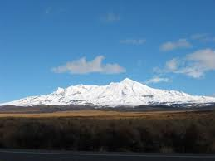
Ruapehu’s Southern Slope
Relief
Built up by tectonic processes (subduction of the Pacific Plate under the Indian-Australian Plate) and as successive volcanic eruptions have added layers of ash and lava to build up the mountain.

Slide 4
Soil
Increases in depth and fertility as altitude decreases. This is due to the vegetation becoming more complex at lower altitudes, which adds organic matter.

Slide 5
Vegetation
Increases in coverage as altitudes decreases, this is related to the soil development, and climate (which is not as harsh at lower altitude).

Slide 6
Vegetation Succession
Complete the handout into your books.

