Slide 1
Evolution and Change
Denudation Processes
Means do what's on the slide
Means read the slide

Slide 2
While volcanic activity in TVC leads mainly to building up the mountains, the weathering-erosion-transport-deposition system is trying to level them down
Weathering and erosion is a process of loosening and removing rock debris
Transport is a process of carrying eroded debris to a new location
Deposition is a process of accumulating the transported material

Slide 3
The processes on the previous slide happen through:
gravity
wind
Ice
Water

Slide 4
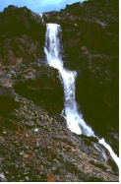
Climate and gravity provides the energy and agents of erosion and deposition (wind, water, ice). Volcanism provides the material substance for these agents to work upon.

Slide 5
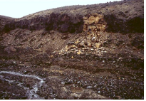
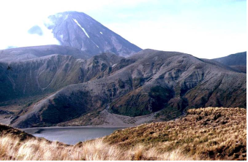
Erosion – Deposition
Weathering and gravity is responsible for this recent lava cliff erosion
Hills surrounding Lower Tama Lake are being subject to gully erosion and scree fans are forming below them

Slide 6
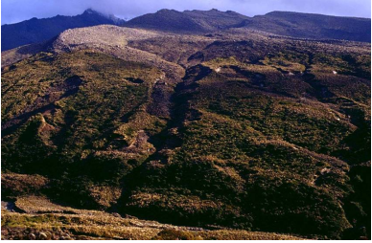
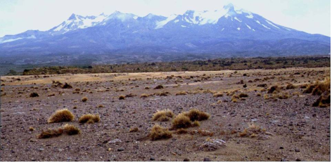
Stream erosion has cut valleys on lower slopes of Mt Ruapehu
Wind erosion on Rangipo Desert

Slide 7
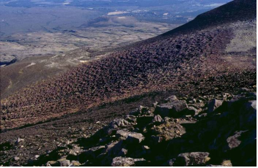
Another kind of erosion process on slopes is solifluction, which is the slow shifting of rock debris downhill
Solifluction is particularly efficient in cold climates where frequent frost-thaw process occurs. It results in the characteristic lobe texture of the slopes.

Slide 8
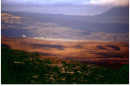
Extensive deposition of lahars, stream sediment and tephra makes the landscape of the large volcanic ring plain around Mt Ruapehu and Mt Tongariro.

Slide 9
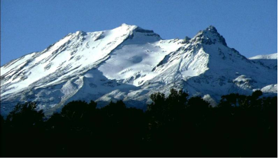
Glaciers can be a powerful landscape-shaping force
Movement of ice over rock leads to rock polishing, erosion and altering the shape of valleys
Moving ice transports rock debris and can deposit it as moraines
Water melted from ice has its own capabilities of eroding, transporting and depositing sediments
A glacial landscape is a landscape either formed or deeply altered by

Slide 10
Work of Wind
How are winds created?
By differences in the atmosphere which causes air to move from high to low pressure.
What does it do?
In the Tongariro Volcanic Zone winds are an effective denudation agent because;
on the mountain top gales are frequent and severe
light ash deposits dry out quickly
on the east of the mountains rainfall is lower

Slide 11
So what does wind do??
Strips fine materials from bare, dry surfaces.
Example: Rangipo Plains.
Tussock is left isolated when the wind erodes all material that is not protected by their matted roots. This can leave tussock on pedestals up to 1m high.
Winds can transport and deposit debris. They carry fine silts and sand particles in dust clouds depositing them downwind.
Example: Rangio DesertSand dune crescents and ridges are forming
Winds also distribute airborne ash during eruptions. Since the winds are predominantly westerly, ash deposits are greatest east of the mountains.

Slide 12
Work of Water
Complete the handout ☺
And activity 2 on page 50 of the Tongariro text.

Slide 13
Work of Ice
The Chateau experiences 142 days of ground frost annually. Temperatures fall as altitude increases. They can be below freezing point at any time on Ruapehu’s summit.
These conditions result in ice being an important agent of weathering, mass movement and erosion.

Slide 14
Heating cooling of rocks
Rocks that freeze at night may heat and expand during the day. This sudden change in temperature may cause the rock to split. This is a form of weathering.
Illustrate:

Slide 15
Ice needles
These push through soil during winter nights, taking small soil particles and stones with them. When the needles collapse during the day, the dislodged particles will roll downhill, resulting in mass movement on a small scale
Illustrate:

Slide 16
Glacial Erosion
Glaciers, which are huge bodies of ice (begin as accumulations of ice and snow in hallows), move downhill under the influence of gravity. As they move they tear away blocks of rock off the floor and walls of valleys, and wear away rocks beneath them. This is a form of erosion.
Illustrate:

Slide 17
Exam time! ☺
Any landscape evolves and changes over time. These changes are due to:
• climatic processes
• tectonic and other internal processes
• erosion, transportation, deposition, and other surface processes.
(i) Select the process or combination of processes that you think has had the most effect on the evolution of your chosen continental landscape.
(ii) Explain how the process(es) has affected the evolution of the landscape.
(iii) Justify why you chose this process(es) as having the most effect.
You may answer this question with a written explanation and justification, or with annotated sketches / maps / diagrams, or with a combination of a written explanation and justification and annotated sketches / maps / diagrams.

