Slide 1
Chapter 5…

Slide 2
The next four slides
Are written descriptions of the evolution of the TVC… you are to leave at least 8 lines after each paragraph so you can draw in the appropriate diagrams afterwards.

Slide 3
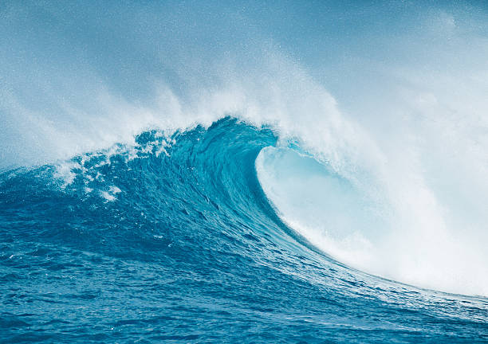
The Evolution of the Tongariro Volcanic Centre
25 million years ago – New Zealand and the area that will become the TVC lies mostly under the sea!

Slide 4
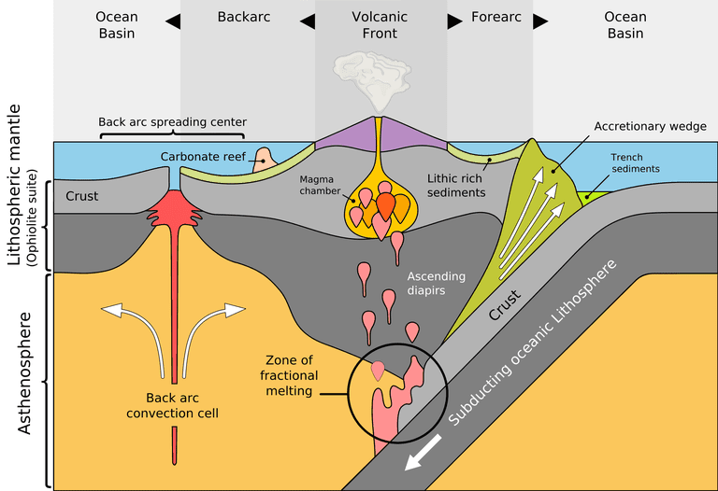
20 million years ago – renewed uplift due to tectonic processes eg. Subduction, faulting and folding

Slide 5
260,000 years ago Proto-Ngauruhoe. An active volcano “Proto-Ngaurohe” soared over the central North Island landscape. During the following ice age it was eventually eroded leaving a stump. U-shaped valleys in between the volcanoes are separated by ridges of resistant lava.
All of the volcanoes (Tongariro, Ngauruhoe and Ruapehu) are probably fed from the same magma chamber and begin to form.

Slide 6
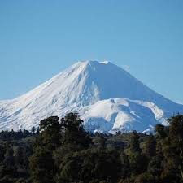
14,000 to present – further volcanic activity in the landscape. 10,000 – 14, 000 BC Ruapehu’s last active mountain building phase. Tongariro’s Red crater forms (9,700 BP). In the last 2,500 years there has been renewed volcanic activity eg. Modern Ngauruhoe forms 1,000 to 2,500 BC, Emerald lakes form 1,800 years BC. Another agent of change, denudation processes, is now changing the landscape.
All of the volcanoes have built composite cones of andesite lava, ash and tephra
They all lie along the same fault in the Taupo Graben
They are all approximately the same age. Youthful Ngauruhoe stands on the stump of a much older cone and is a parasitic cone formed from the main vent of Mt Tongariro

Slide 7
Which phases were:
Tectonic processes?
Erosion, transportation?

