Slide 1
Large Natural Environments
Exam Thursday 22nd November am

Slide 2
What is a Large Natural Environment?
An area of the earths surface that has its own particular type of relief, climatic, soil and vegetation features.
Each natural environment has four elements that interact and affect each other to produce these distinctive environments
RELIEF, CLIMATE, SOIL and VEGETATION

Slide 3
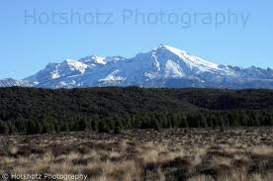
Relief - Shape of land

Slide 4
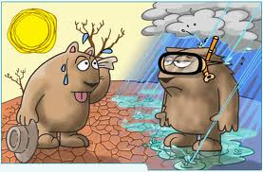
Climate – the usual weather patterns (temperature, rainfall, wind) of a region

Slide 5
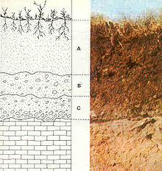
Soil - a natural body consisting of layers (soil horizons) of primarily mineral constituents of variable thicknesses, which differ from the parent materials in their texture, structure, consistence, colour, chemical, biological and other physical characteristics

Slide 6
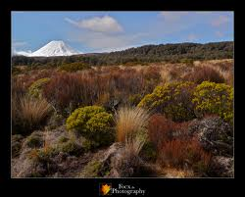
Vegetation – General term for plant life

Slide 7
Draw this into your book on one whole page leaving enough room to add text to it.
Relief
Soil
Vegetation
Climate

Slide 8
Add these to your ecosystem model
The higher the altitude, the colder the temperature
A high iron content in sand will cause it to become hot and moisture will rapidly evaporate
The steeper the slope the thinner the soil
The cold conditions at high altitude cause freeze-thaw resulting in erosion which modifies the relief
Dead vegetation on a forest floor rich in organic material creates a thin soil layer called humus

Slide 9
A high level of evapo-transpiration results in convectional rainfall.
Roots can modify relief by digging into cracks causing erosion
Fertile soil generates a higher level of plant growth than poorer soil.
Sandy soil is more easily eroded than clay.
The higher the altitude, the shorter and sparser the vegetation
Heavy rainfall can drain the soil of minerals (leaching)
Warm, moist conditions produce the most luxuriant plant growth

Slide 10
Ecosystem
Illustrate your model

